Slide 1



Urooj Ilyas
PORTFOLIO
2025

Slide 2

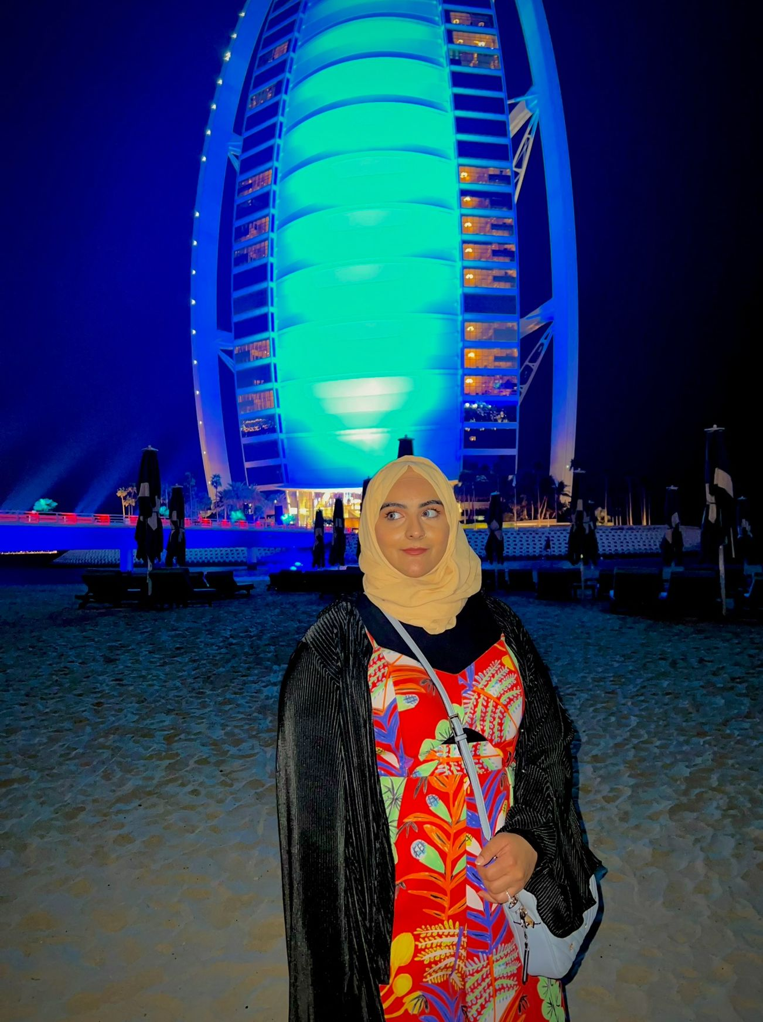

About me
Hi I’m Urooj Ilyas
I was born in Pakistan and raised in the vibrant, multicultural city of Dubai. My academic journey took me to the American University of Sharjah, where I completed my Bachelor’s in Chemical Engineering. Now, I am pursuing my Master’s in Molecular Science and Engineering at KTH in Stockholm. I am passionate about meeting new people, building friendships, and exploring cultures; socializing is truly one of my joys in life.
As a self-declared foodie, I love discovering new cuisines and sharing meals with friends from around the world. Above all, I am deeply curious and driven by a love for research. Whether in the lab or outside of it, I am always eager to learn, discover, and share knowledge with others.
graphic designer
+46733193823 • urooj007elyas@gmail.com / urooj@kth.se

Slide 3
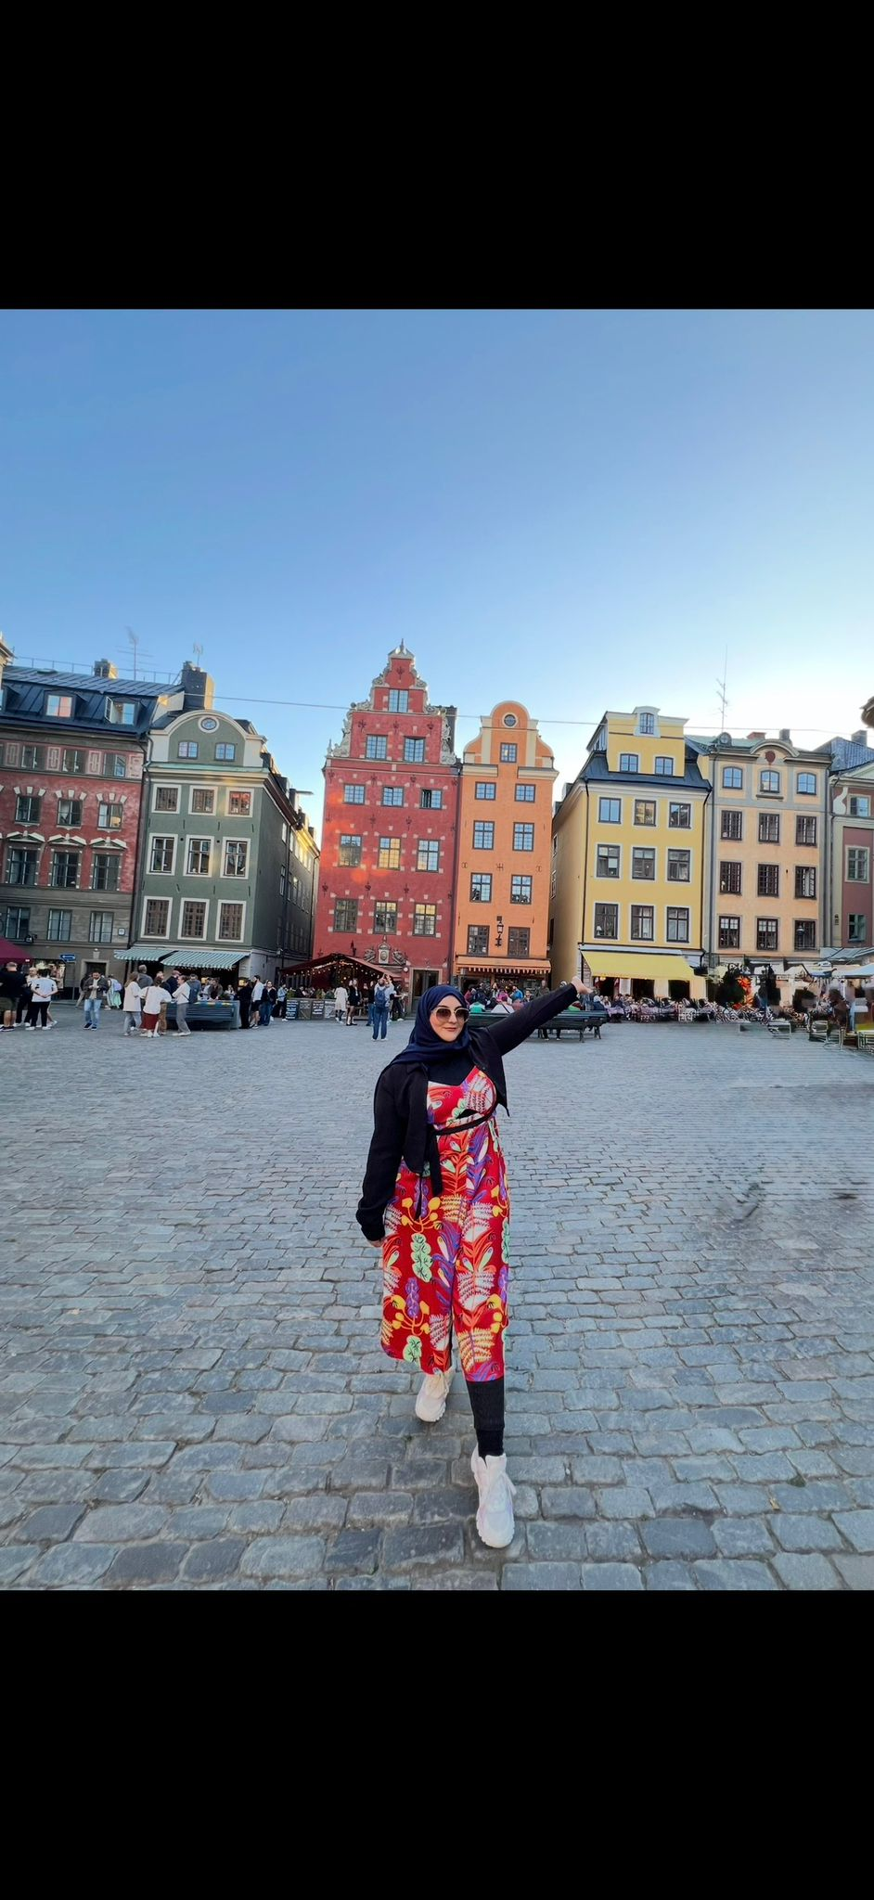
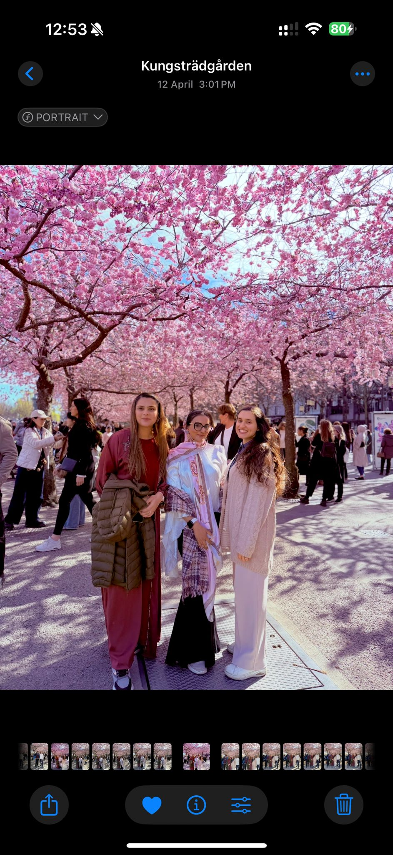
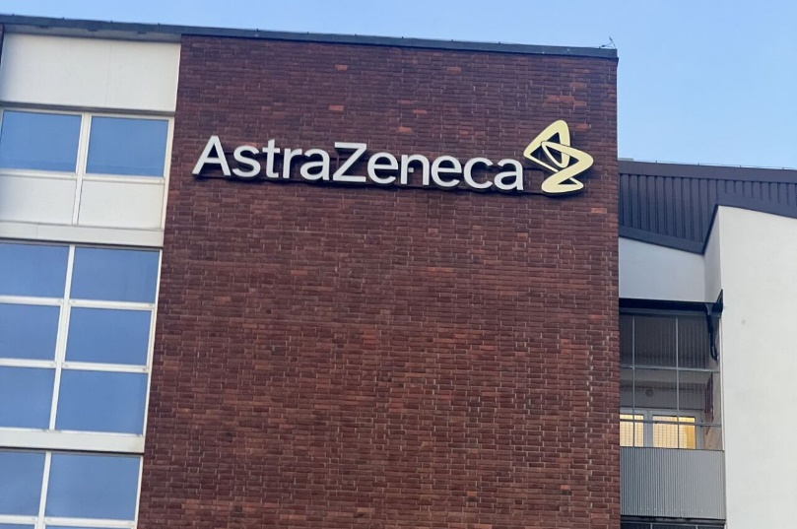
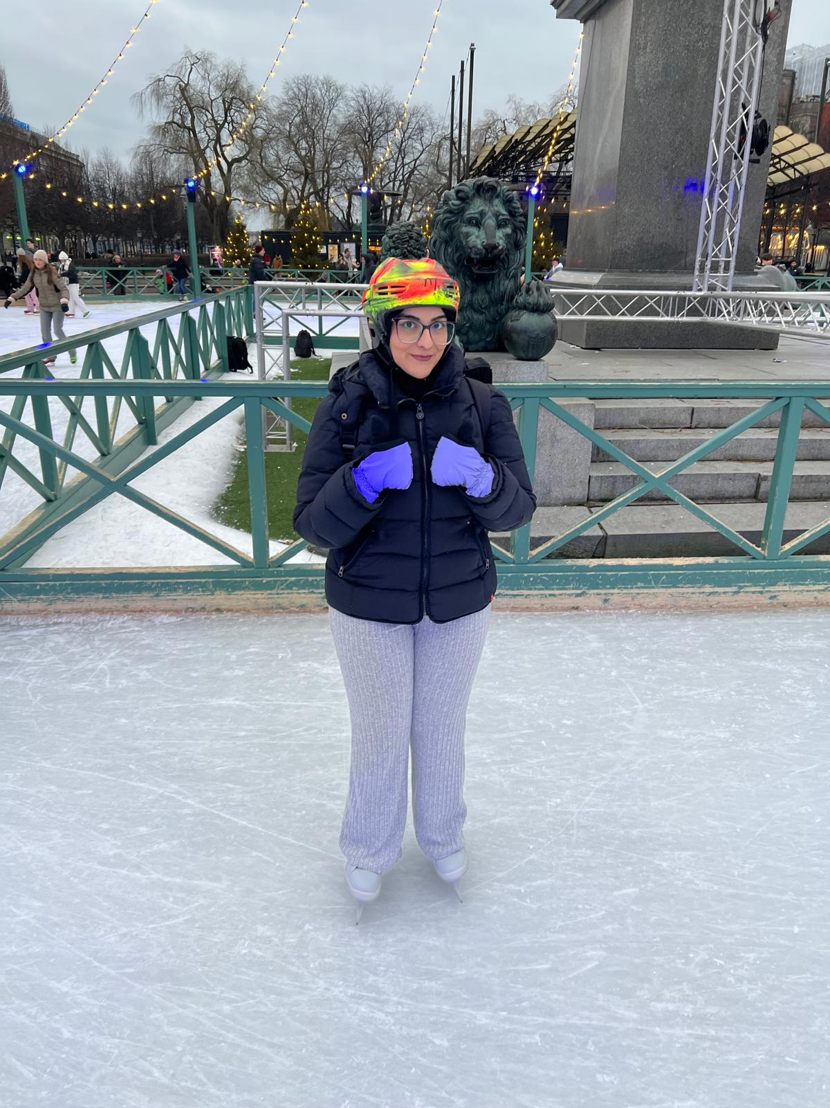
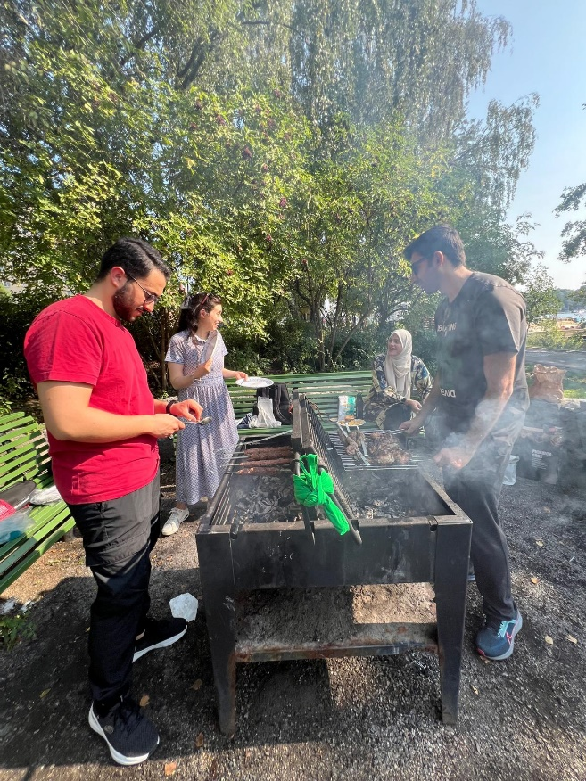
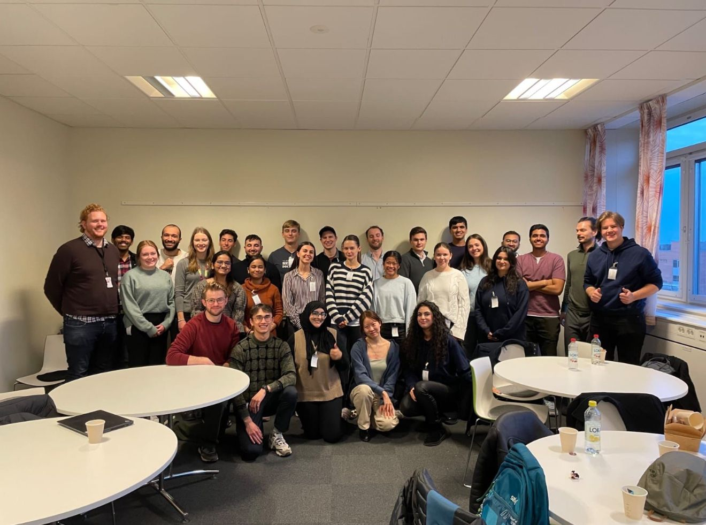
My life in Stockholm

Slide 4
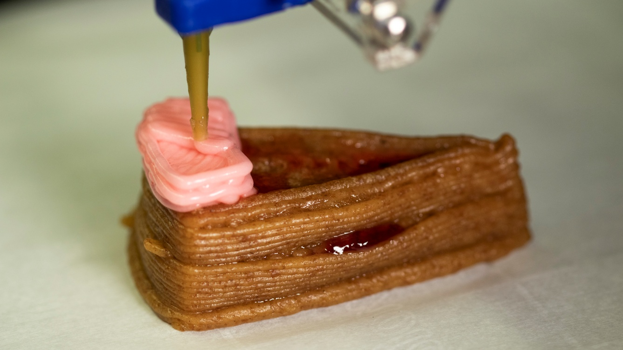
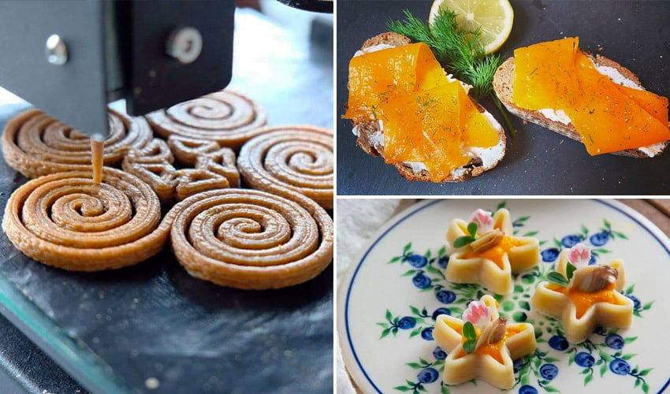
Education
Jan 2026 – June 2026 (Ongoing)
Masters Thesis: 3D Printed Food Inks
Quantitatively mapped interfacial and bulk rheology to 3D printability, identifying the physicochemical mechanisms governing emulsion stability and shape retention.
Developed science-based guidelines for clean-label food inks by analyzing protein adsorption kinetics and polysaccharide gelation networks.

Slide 5

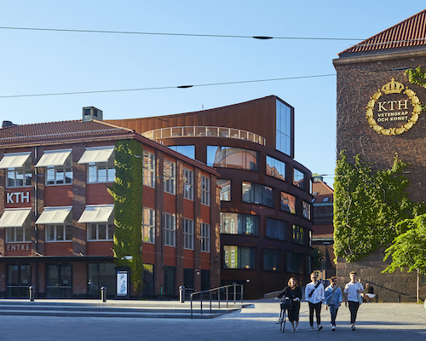
Education
Masters at KTH
Pursuing Masters in Molecular Science and Engineering at KTH Royal University, Stockholm, Sweden
I am also the International Student Ambassador for my Program.
2-year Master Program focusing on Molecular Science, Surface Chemistry, Polymer Science, Spectroscopic Tools, with sustainability at its core.

Slide 6
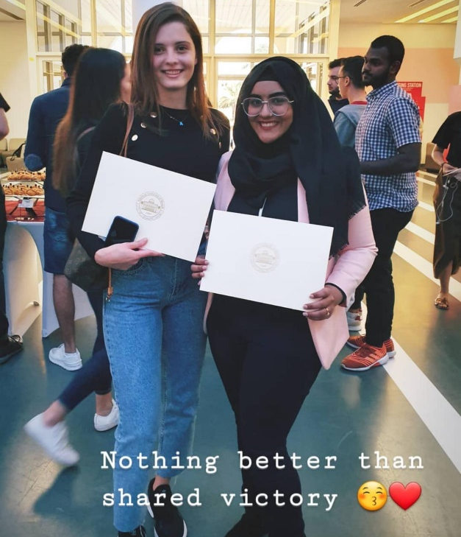
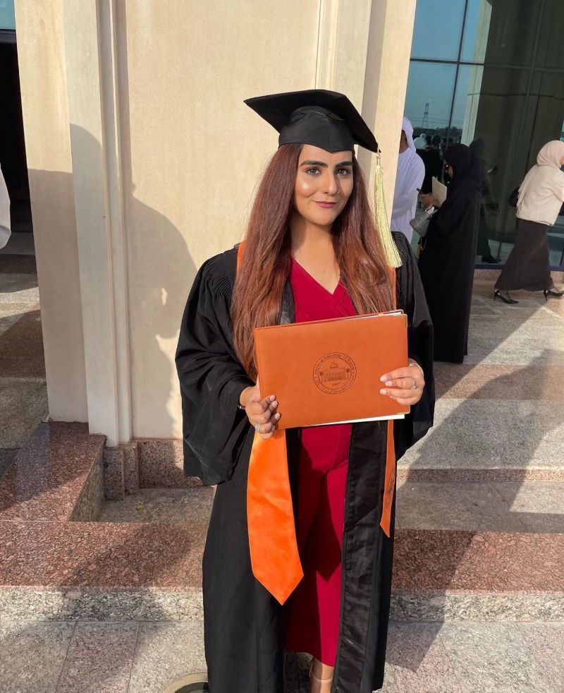
Education
Bachelors
Scholarships
Bachelors in Chemical Engineering from American University of Sharjah, UAE with Magna Cum Laude Honor Graduated in 2022
Multiple scholarships and honors, including:
Active Student Scholarship – three times in a row
Petrofac Endowment Scholarship based on community engagement and merit.
Consistently listed on the AUS Dean’s and Chancellor's Lists for exceptional academic performance.
AUS Undergraduate Research Grant

Slide 7
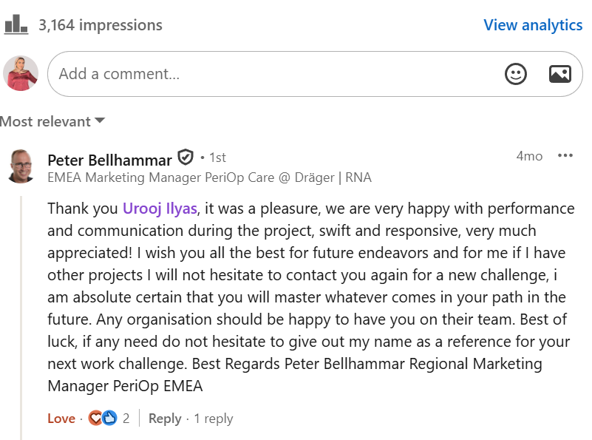
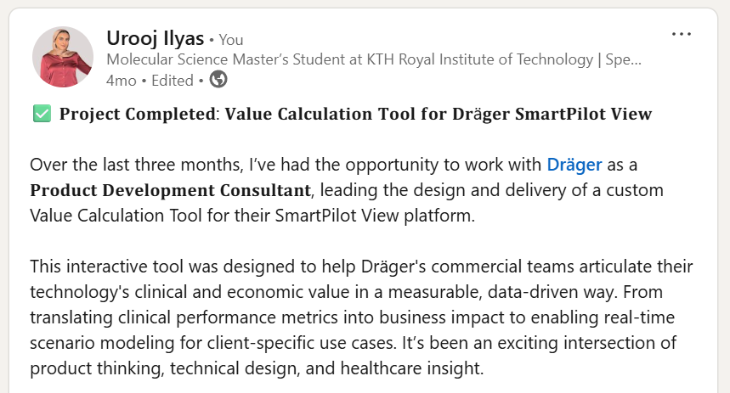
Work Experience
May 2025 - August 2025
Dräger - Product Developer Consultant
Developed a customized VBA-based dashboard that reduced analysis time by 40% and improved decision-making.
Highly appreciated by stakeholders and managers
graphic designer

Slide 8
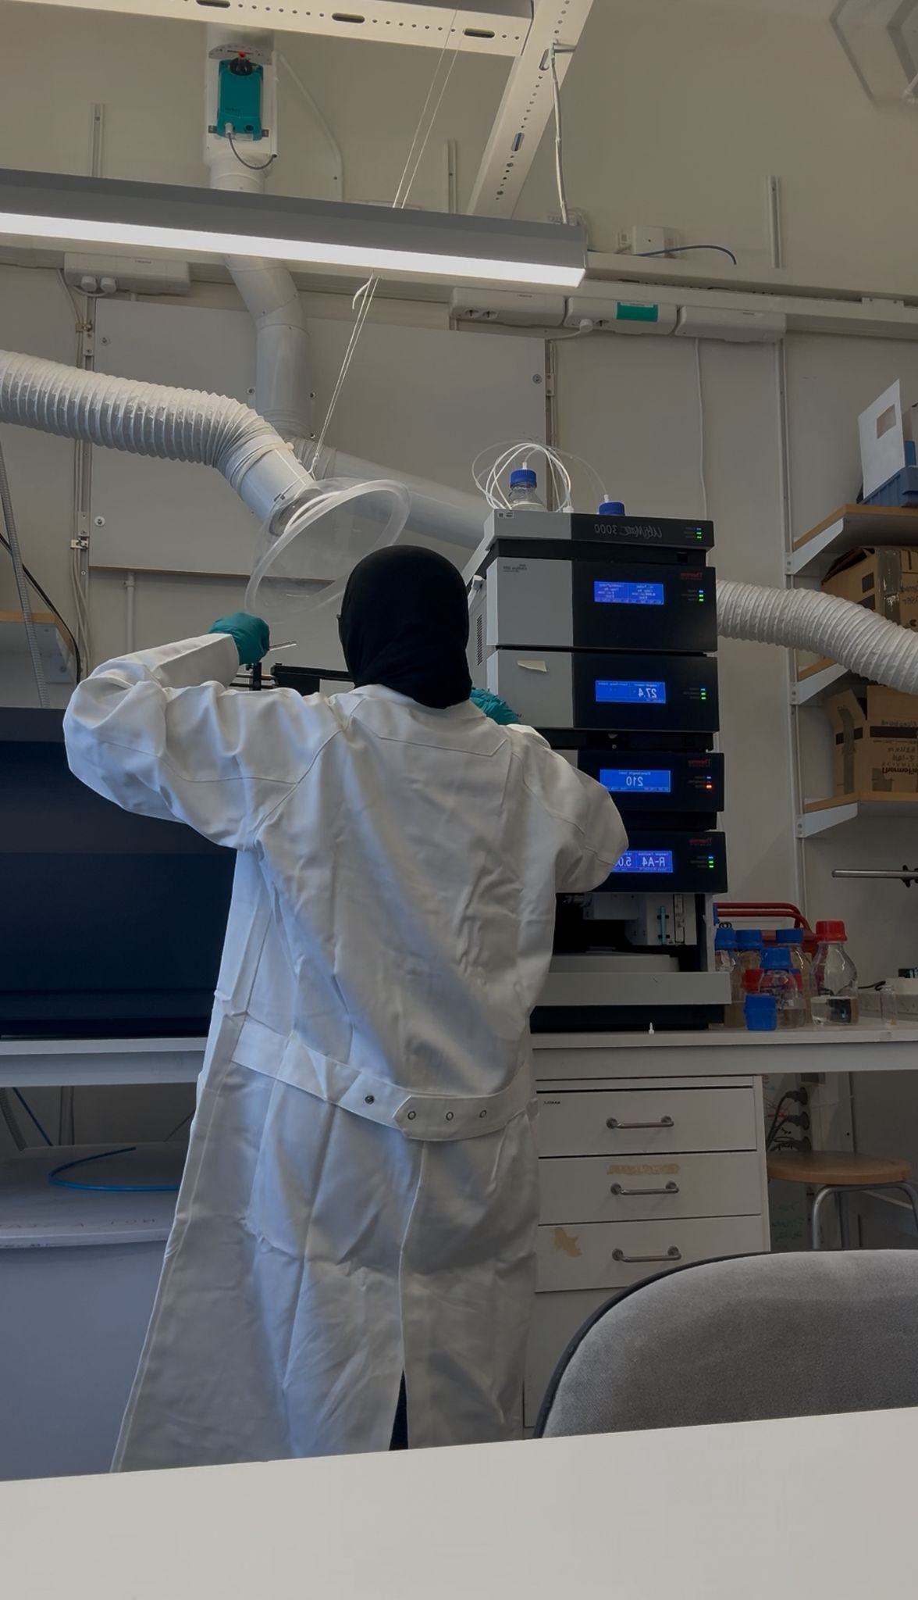
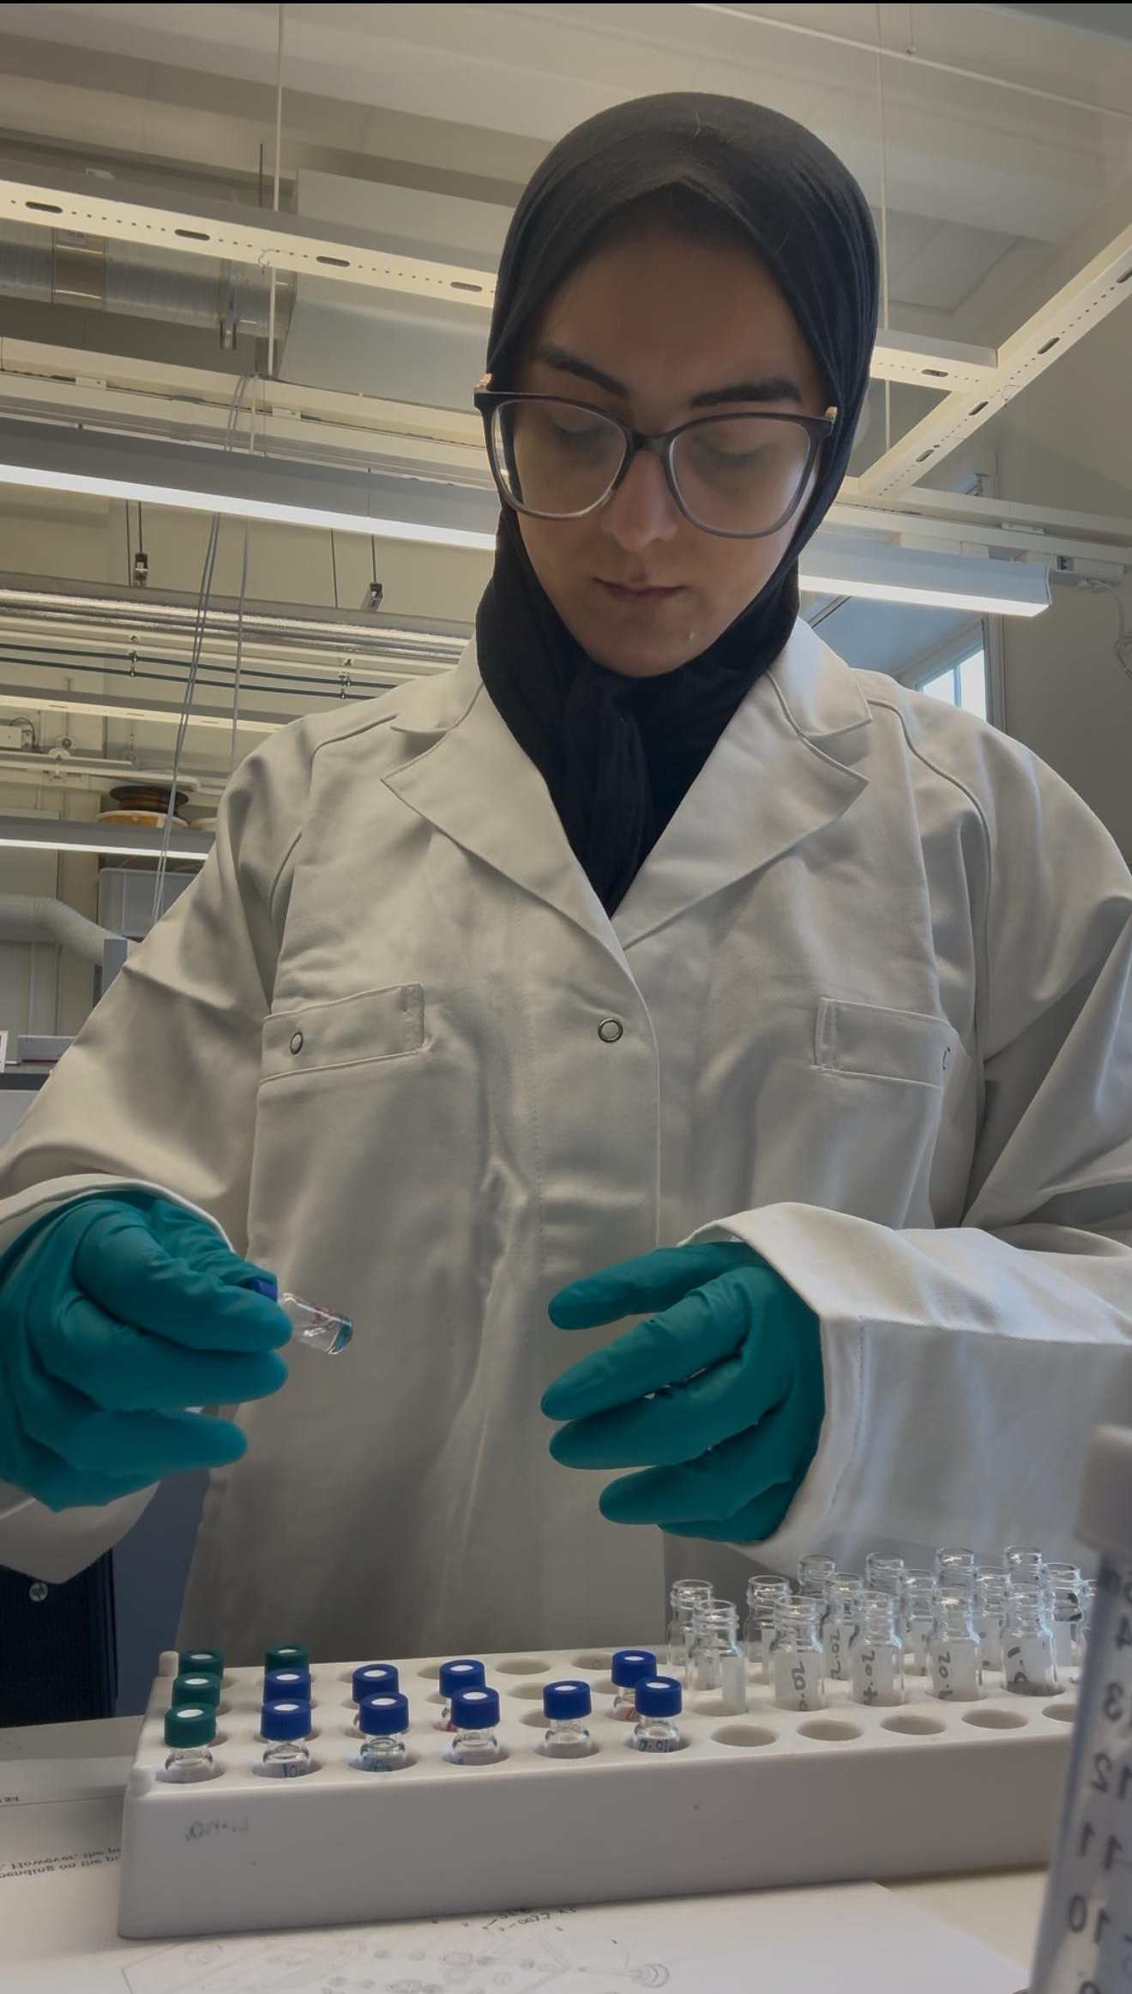
Work Experience
January - May 2025
KTH - Student Researcher
Performed a time–temperature resolved study to assess how solvent choice influences mass spectrometry data quality.
Investigating Solvent Interactions of Antioxidant Used for Plastic Food Packaging
Used tandem MS/MS to identify solvent cluster structures, improving understanding of molecular interactions and reproducibility.
Gained expertise in linking molecular-level solvent effects to system performance, a skill directly transferable to investigating how wetting agents, dispersion, and rheology modifiers affect paint formulations.
graphic designer

Slide 9
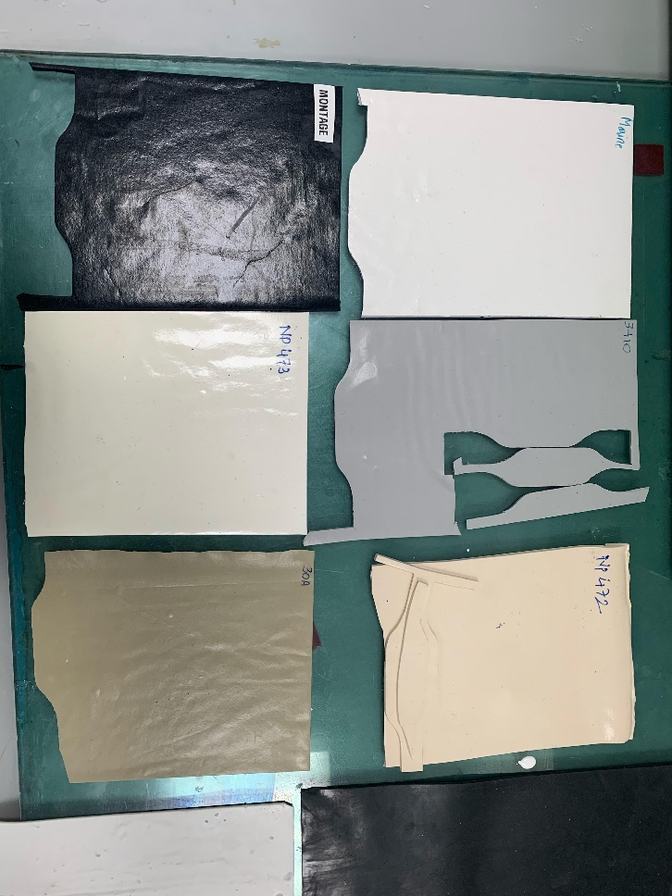
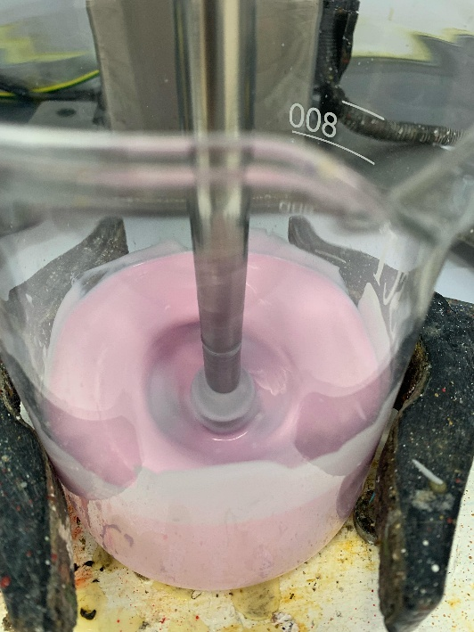
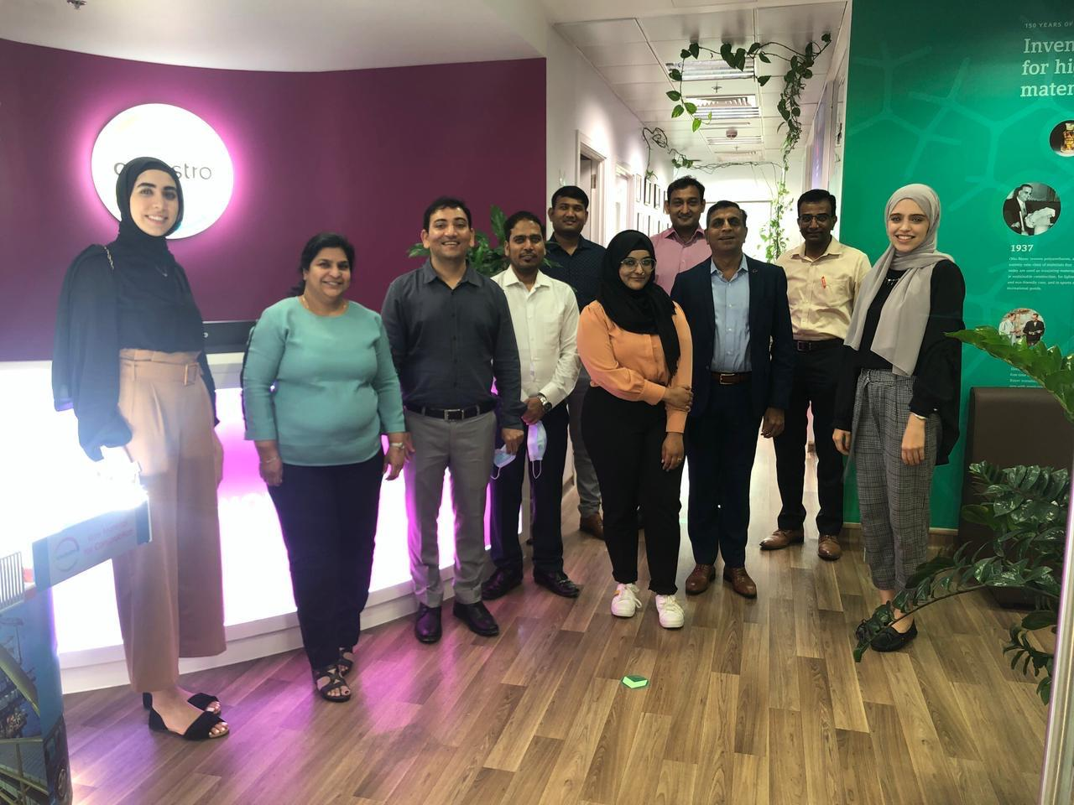
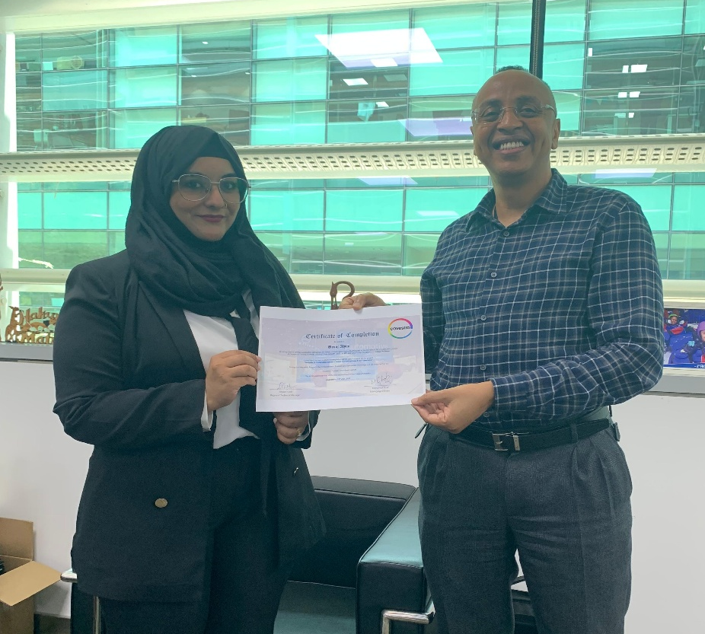
Work Experience
June – August 2021
Covestro -
Formulation R&D Intern
Optimized polyurea formulations, assessing curing agent effects on viscosity, flow, and application.
Applied rheology and surface chemistry to evaluate stability and performance.
Completed training in circular economy, deepening knowledge of sustainable materials and life-cycle impact.
graphic designer

Slide 10
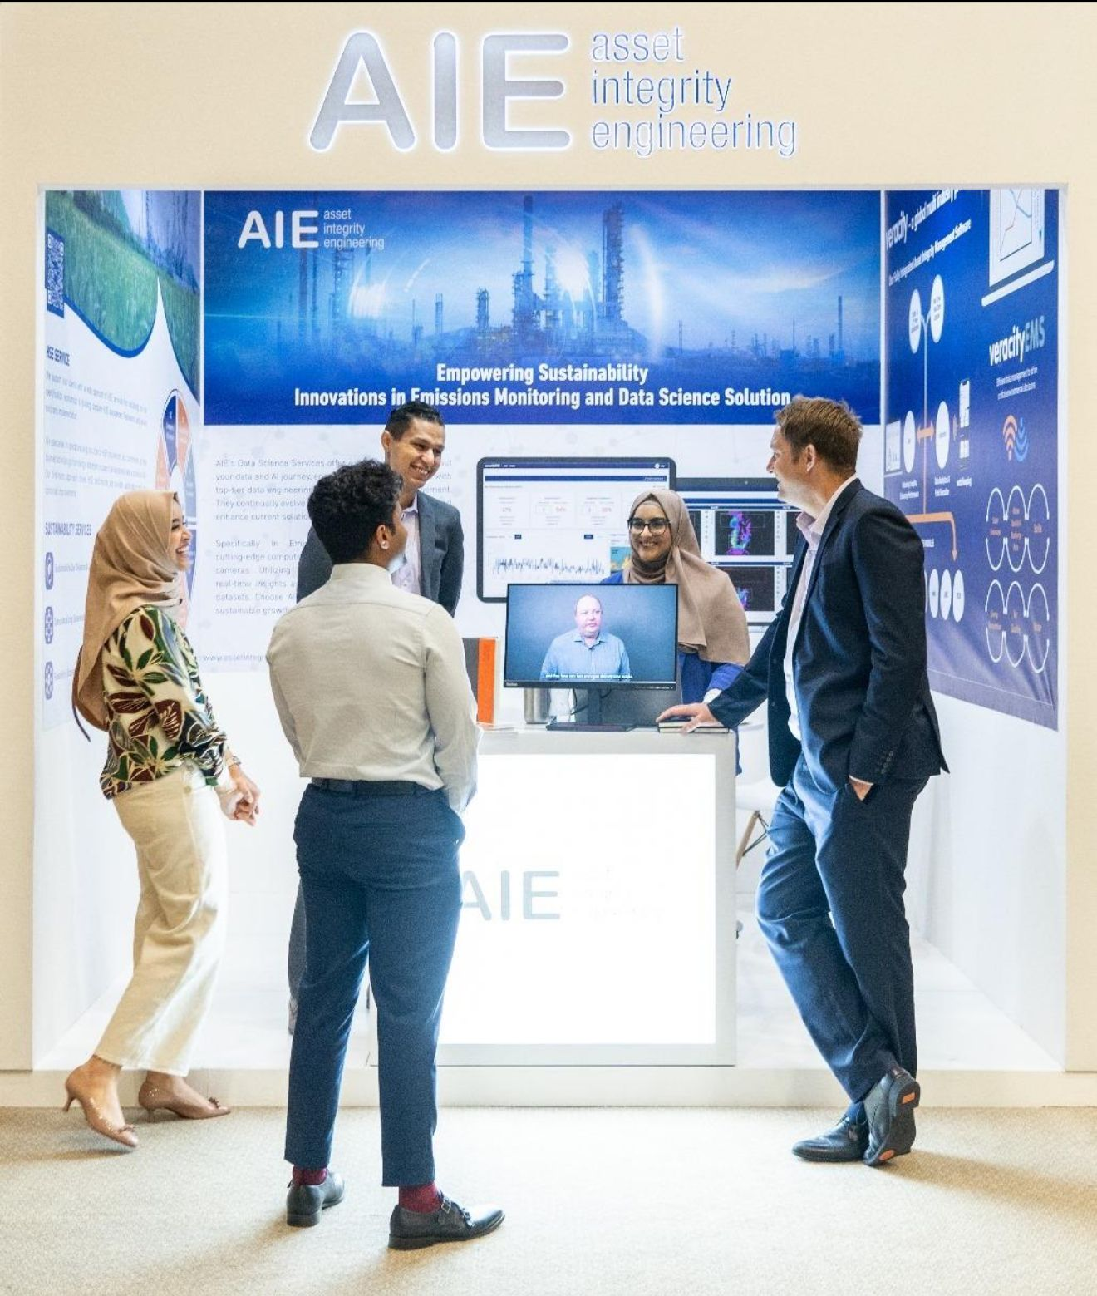
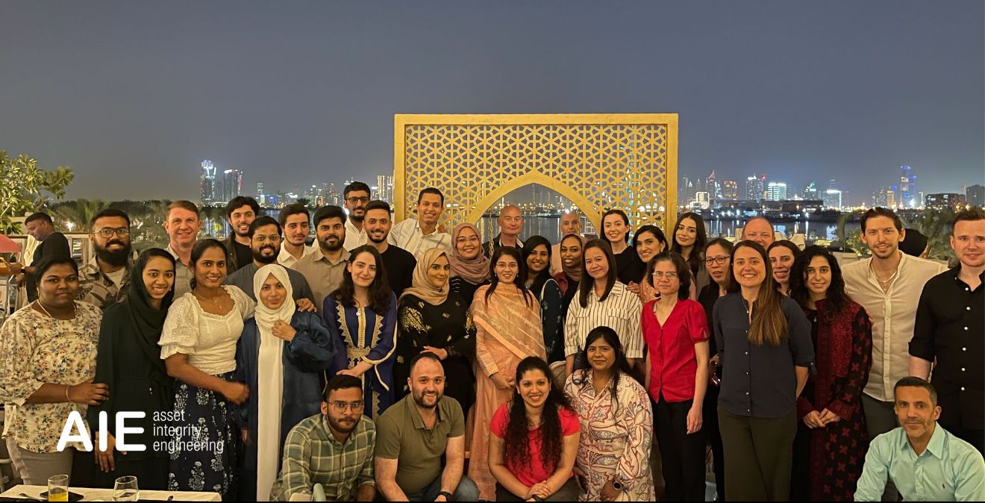
Work Experience
April 2022 – July 2024
AIE - Engineer & Sustainability Lead
Worked in Sharjah, UAE for 2 years after bachelors in Marketing and Engineering Consultancy.
Handled multiple clients and deliverables.
Was the face of AIE in multiple conferences.
graphic designer

Slide 11
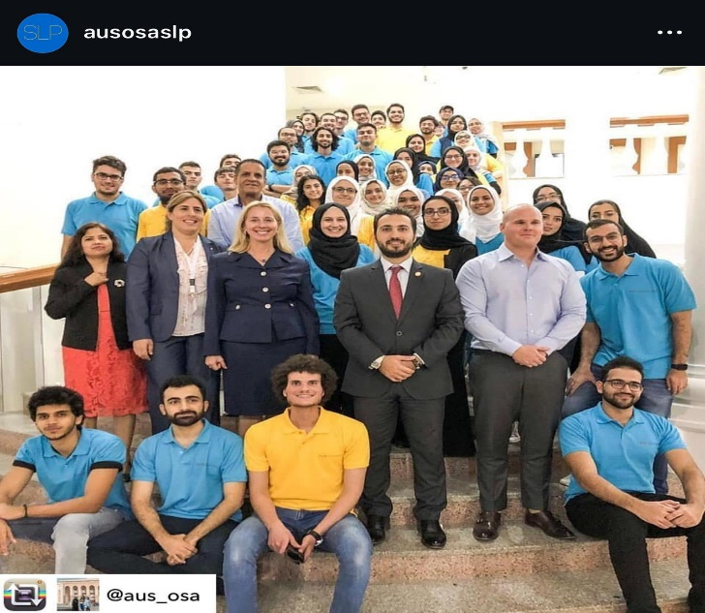
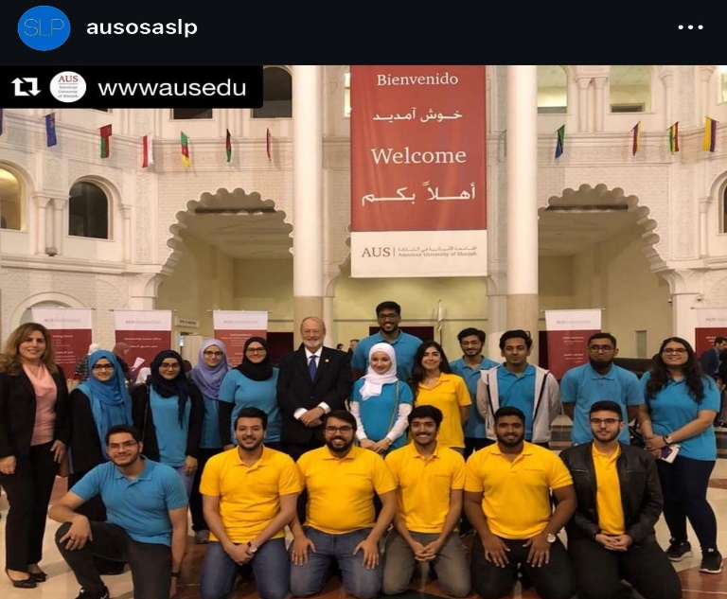
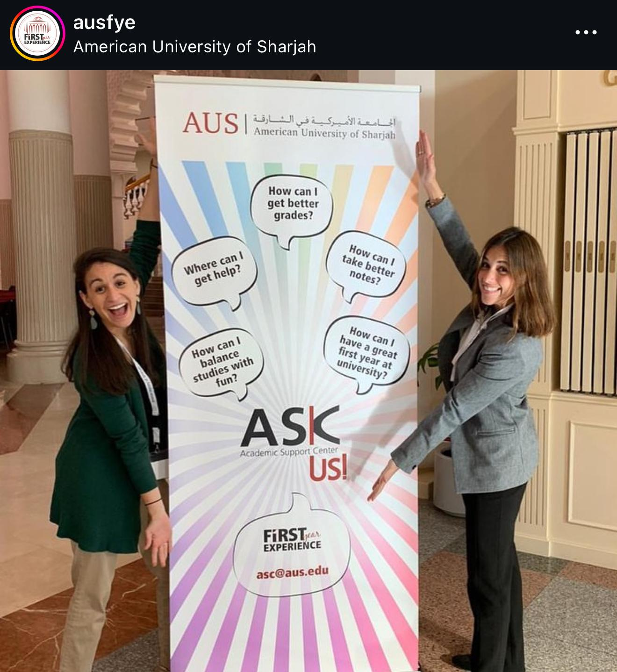
Student Leadership Experience
Student Leadership Program
Peer Leader and Team Leader for 2 years at AUS
CEN Ambassador for my program
Part of First Year Student Mentorship Program
Mentored multiple students (one-to-one)
Delivered numerous study skills workshops
graphic designer

Slide 12
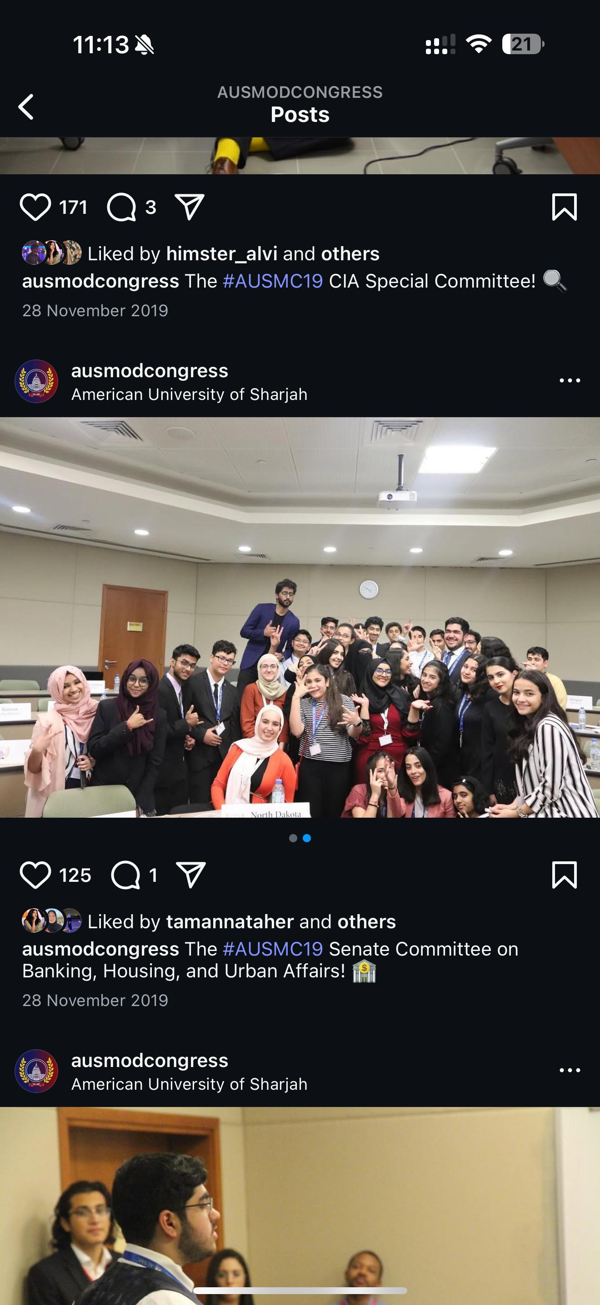
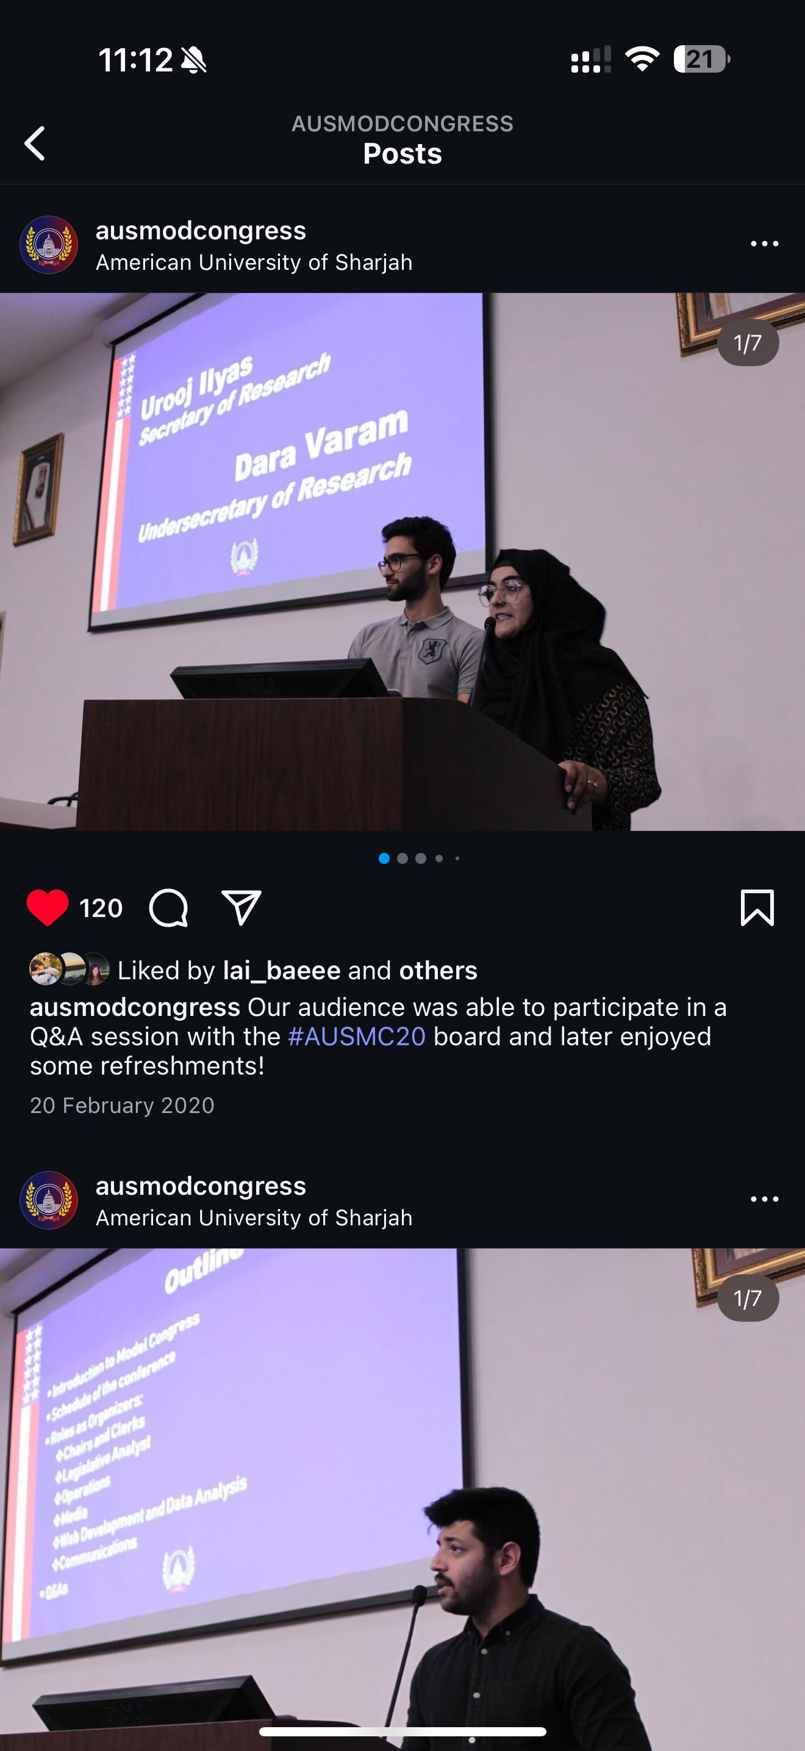
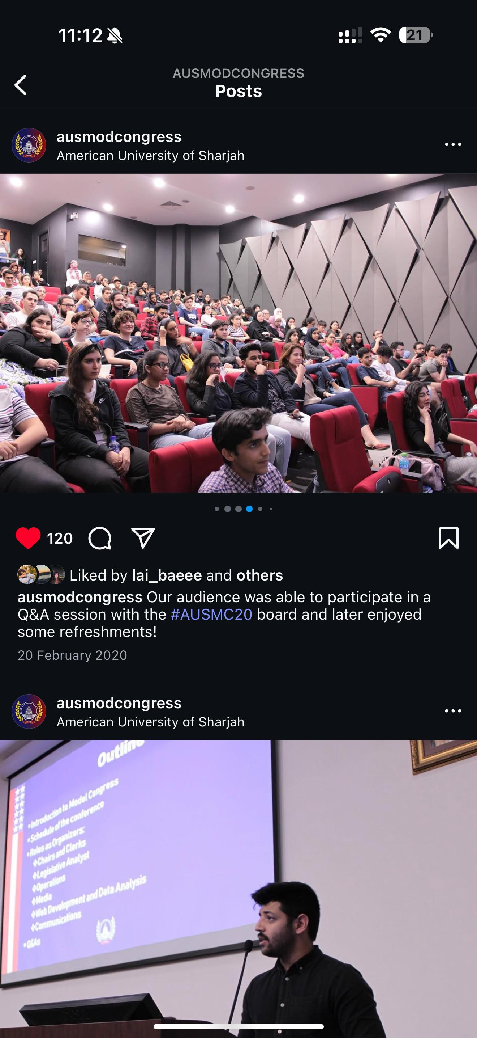
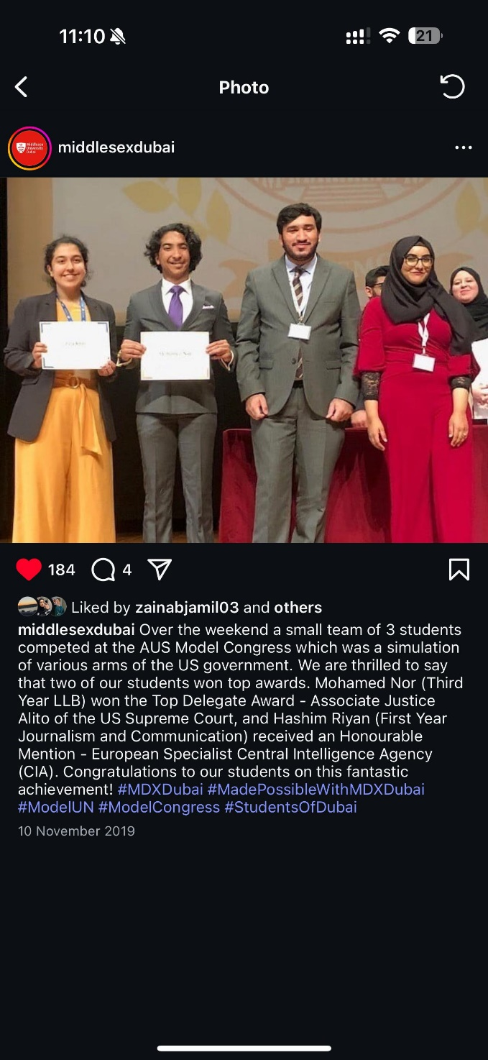
Conference and Board Experience
Executive Board Member
Part of Model Congress Executive Board as a Secretary of Research -twice
Led a team of 20 researchers, training them and assigning deliverables for the conference with 1000 participants from all the schools in UAE.
Delivered numerous workshops to high school students on research tips
Judged committee discussions

Slide 13
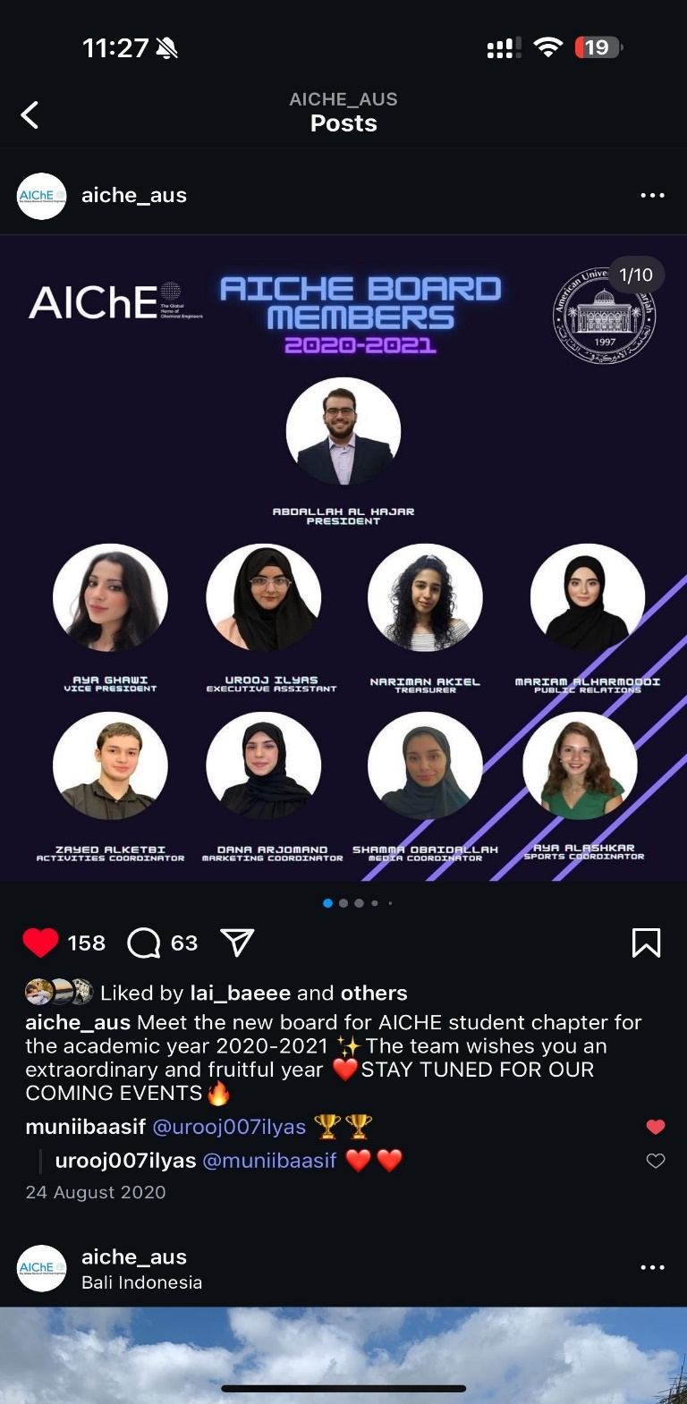
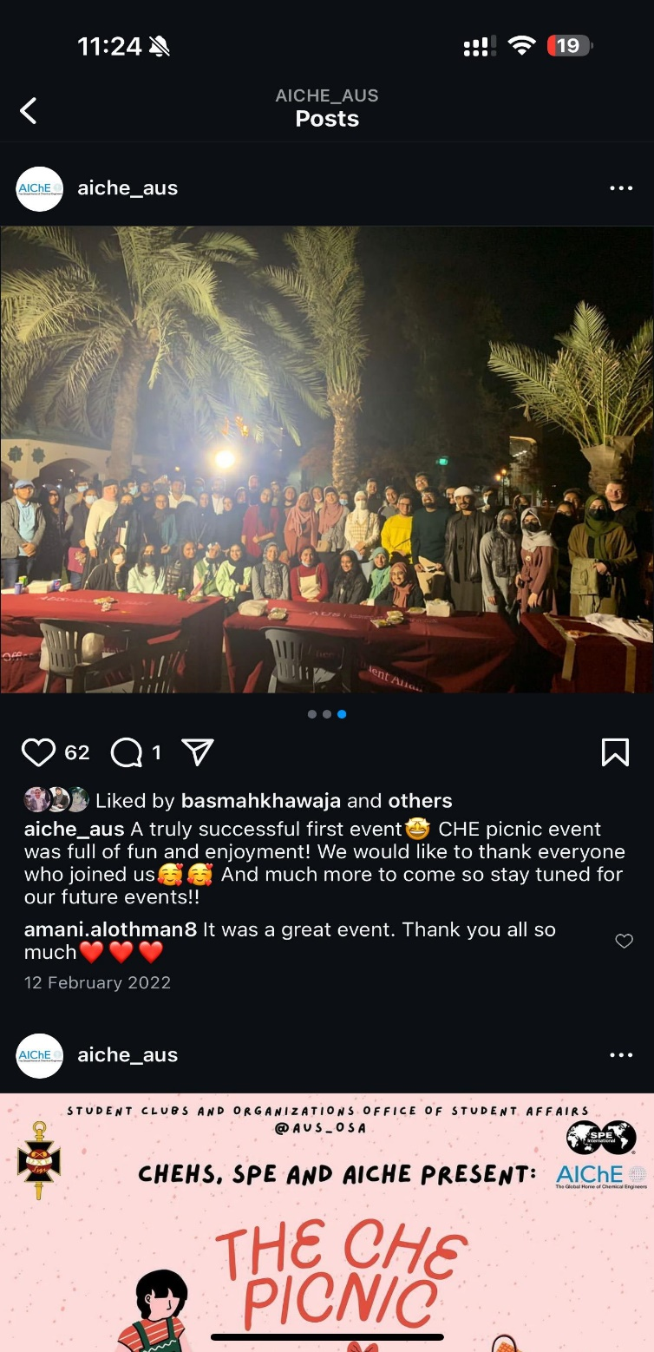
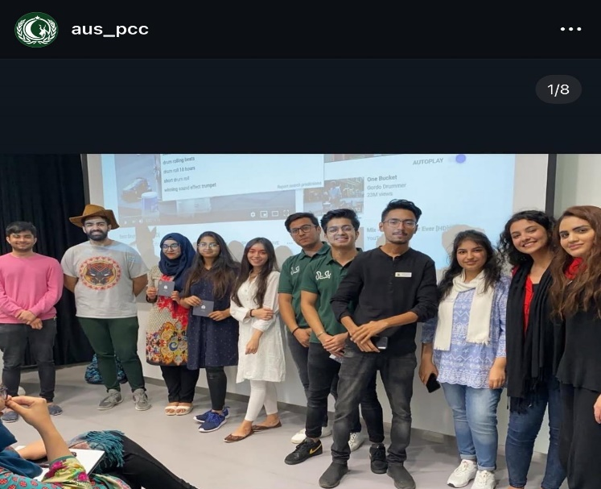
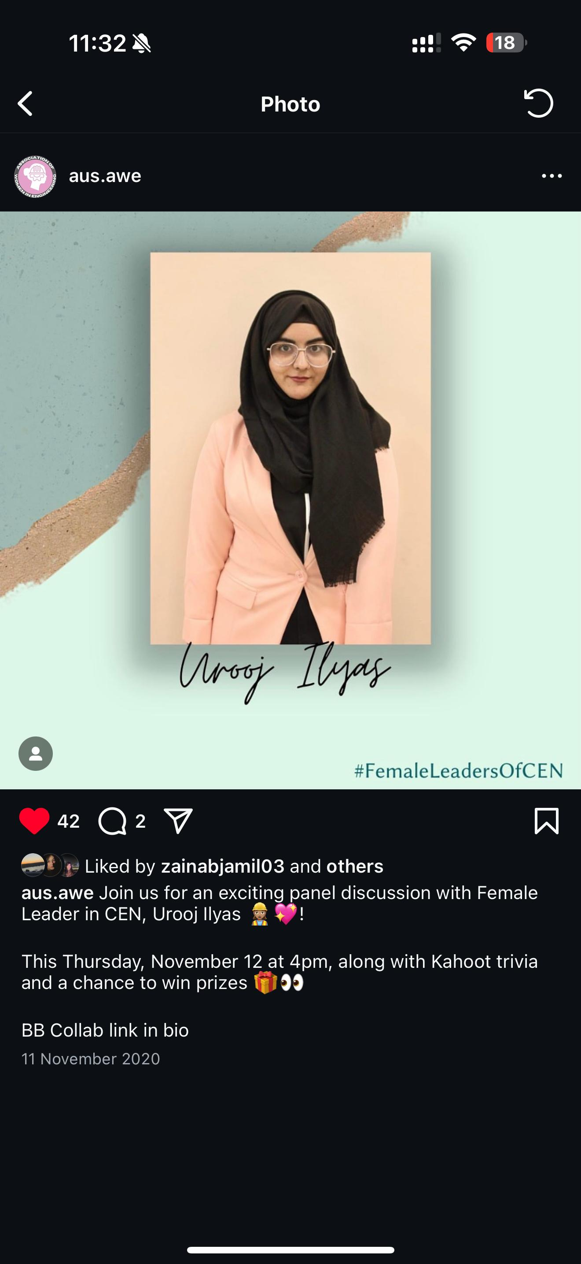
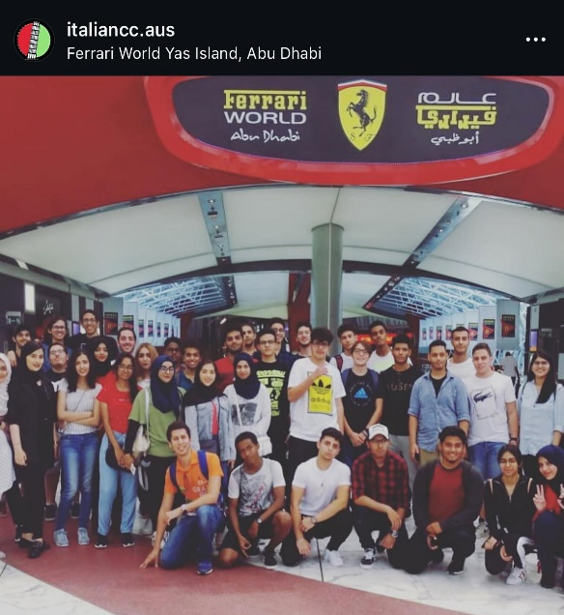
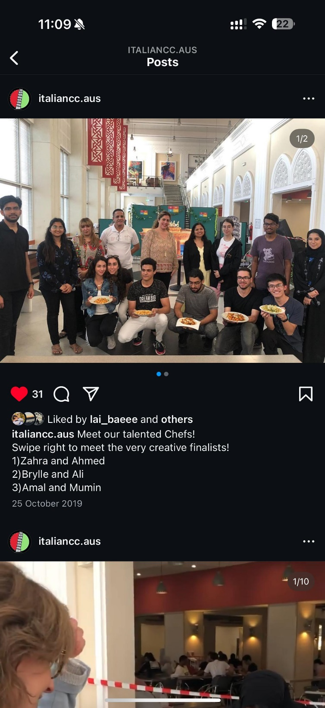
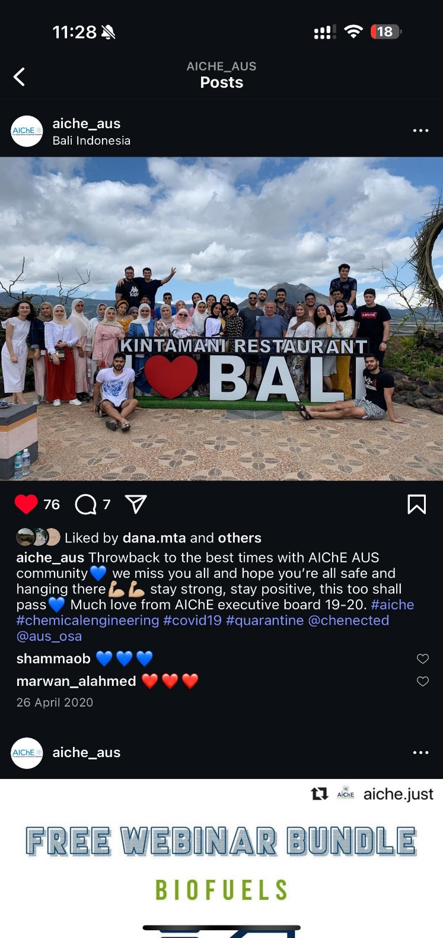
Organized and Hosted Countless Events
2024

Slide 14






Why Hire Me?
Communication & Collaboration: Experienced in presenting research, facilitating stakeholder workshops, and mentoring peers; skilled at translating complex science into clear insights.
Leadership & Initiative: Coordinated student and professional events for 100+ participants, showing reliability and organizational strength.
Global & Culturally Adaptable: Citizen of Pakistan, raised in Dubai, now studying in Sweden; comfortable working in international and cross-functional teams.
Passion for Science & Sustainability: Driven by curiosity and motivated to apply research in formulation, rheology, and coatings innovation to real-world sustainability challenges.
Multilingual: Fluent in English, Urdu, Hindi, Punjabi, with basic Arabic and Swedish; able to collaborate across diverse teams
Positive & Approachable: Known for fostering inclusive teamwork and supporting colleagues in achieving shared goals.
graphic designer

Slide 15



Let’s Work
TOGETHER!
Contact me via:
Call: 46-73 319 3823
Email: urooj@kth.se / urooj007elyas@gmail.com
Linkedin: www.linkedin.com/in/urooj-ilyas

